Slide 1
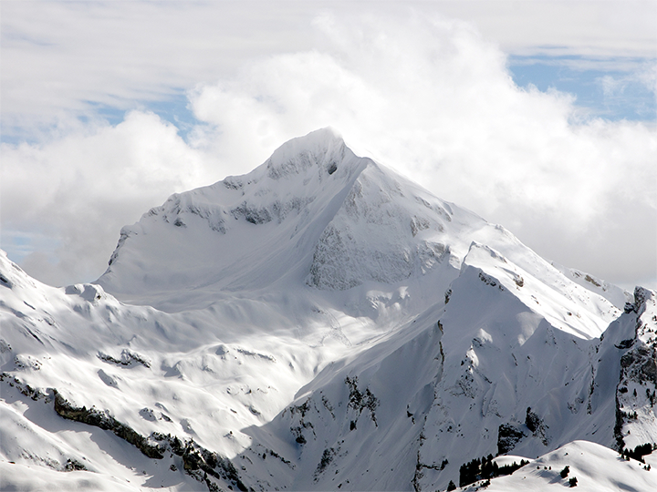

So You Think You Know
Financial Disclosure?
Deborah Bortot, Sandra Mabry, and Heather Jones

Slide 2
Rings Twice Strategic International Growth Hedging Strategies IV, LP
1. Does the fund qualify as an EIF?
2. Do we need a list of the underlying holdings?
3. If filer cannot obtain a list of holdings, what can he do?
4. How does filer report this entry?
5. What information do we need to perform a conflicts analysis?

Slide 3
An excepted investment fund is an investment fund that is:
i. independently managed
ii. widely held* and
iii. either publicly traded or available** or widely diversified***
*A fund is widely held if it has at least 100 investors.
*A fund is publicly traded or available if it was ever open to investors from the public, even if it was restricted by minimum wealth or investment requirements and even if it was restricted to “accredited investors.”
***A fund is widely diversified if it holds no more than 5% of the value of its portfolio in the securities of any one issuer (other than the United States).
See OGE legal advisories LA-14-05 (9/30/2014) and DO-08-022 (7/22/2008),
Financial Disclosure Requirements for Pooled Investment Funds

Slide 4
Conflicts Analysis
Does the fund qualify for one of the exemptions in 5 C.F.R. 2640?
Does filer know the underlying holdings of the fund?
Does the fund manager reveal the underlying holdings of the fund?
Does filer need to obtain a letter from the fund manager?
Can filer rely on no knowledge?
Does filer need to divest the fund?

Slide 5
Q 6: Incentive Stock Option Valuation
If the filer knows the value of the option, the filer should disclose the value.
If the options are underwater or the value is unknown or difficult to determine, write “Value not Readily Ascertainable” and include:
the name of the stock
the number of shares
the strike price
the expiration date
whether options are vested or unvested
the date on which the option will vest, if the option is unvested

Slide 6
Q 7: Unvested Options Issues
Filer will not be able to exercise without accelerated vesting
Accelerated vesting raises 503 or 209 questions, depending on the timing
A certificate of divestiture is not available for the exercise of incentive stock options
A plan for the options will need to be addressed in the Ethics Agreement

Slide 7
Q 8: Additional Assets and Income
Retirement Accounts such as a 401(k) or pension
Severance
Bonus

Slide 8
Q 9: Disclosing a Small Business on Part 2
OGE requires filers to provide a value for a small business, which can be a good faith estimate. OGE suggests the following valuation methods:
The purchase price
A recent appraisal
The assessed value for tax purposes
The year-end book value (for non-publicly traded businesses)
The net-worth of the business
The equity value
Any other recognized indication of value

Slide 9
Q 9: Part 2 Disclosure
Description | EIF | Value | Income Type | Income Amount
Spade & Archer, LLC | N/A |  | LLC Distribution | $1,250,500
Spade & Archer, LLC, anticipated LLC distribution | N/A | $100,001 - $250,000 |  | None (or less than $201)
Spade & Archer, LLC, equity interest | N/A | $1,000,001 – $5,000,000 |  | None (or less than $201)

Slide 10
Q 10: Ethics Agreement
Resignation from position as co-managing member
An 18 U.S.C. § 208 recusal to all particular matters affecting Spade and Archer LLC until he has sold his interest in the business
A discussion regarding the planned sale of the business within 90 days of confirmation
A 1‐year recusal under 5 C.F.R. § 2635.502 from particular matters in which Spade & Archer is a party or represents a party
A 1‐year recusal from the last date of service under 5 C.F.R. § 2635.502 from particular matters in which one of Mr. Archer’s former clients a party or represents a party

Slide 11
Q 10: Divesting an Interest in a Small Business
For a conflicting small business interest, the filer needs to have either:
a definitive sales plan at the time of preclearance, or
an agreement to forfeit if the sale does not come together quickly enough after confirmation.

Slide 12
Q 11: Part 3 Small Business Disclosures
Employer or Party | City/State | Status and Terms | Date
Spade & Archer, LLC | NY, NY | Pursuant to the LLC agreement, following my withdrawal from the firm, I will receive my final LLC distribution in four quarterly payments. The total amount of the payments will be calculated as of the date of my withdrawal. | 4/03
Spade & Archer, LLC | NY, NY | Pursuant to the LLC agreement, following my withdrawal from the firm, I will sell my interest to two of the current partners of the firm. The firm will change its name to Spade Consulting, LLC. | 4/03

Slide 13
Q 12: Deferred Compensation
The deferred compensation plan is in the form of cash
The amount is fixed at $150,000 and will not increase before his appointment
He has not received any payments under this plan yet
The $150,000 will be paid out in three equal installments over a period of three years following his resignation

Slide 14
Q12 & Q13: Deferred Compensation
Part 2: Filer's Employment Assets & Income and Retirement Accounts
Part 3: Filer’s Employment Agreements and Arrangements
Description | EIF | Value | Income Type | Income Amount
Pacific All Risk Insurance Company, deferred compensation: cash receivable | N/A | $100,001 - $250,000 |  | None (or less than $201)
Employer or Party | City/State | Status and Terms | Date
Pacific All Risk Insurance Company | San Diego, CA | Following my resignation, I will receive a cash payout of my deferred compensation in three equal installments over a period of three years. | 2/09

Slide 15


Q 14: Deferred Compensation
1‐year recusal under 5 C.F.R. § 2635.502?
2-year recusal under 5 C.F.R. § 2635.503 ?
18 U.S.C. § 208 recusal to all particular matters affecting Pacific?
18 U.S.C. § 208 recusal to particular matters affecting Pacific’s ability or willingness?

Slide 16
Q 14: Deferred Compensation
Ethics Agreement
    Resignation from Pacific
    1-year 5 C.F.R. § 2635.502 recusal from particular matters in which Pacific is a party or represents a party
    Ability or willingness recusal from Pacific until he has received all of his deferred compensation

Slide 17
Deferred Compensation
Instead of being fixed, what if the deferred compensation is invested in underlying assets?
Description | EIF | Value | Income Type | Income Amount
Pacific All Risk Insurance Company, deferred compensation:
-- Pacific All Risk Insurance | N/A | $100,001 - $250,000 |  | None (or less than $201)

Slide 18
Deferred Compensation
What if the deferred compensation plan tracks the performance of the S&P 500?
Description | EIF | Value | Income Type | Income Amount
Pacific All Risk Insurance Company, deferred compensation: tracks S&P 500 | N/A | $100,001 - $250,000 |  | None (or less than $201)

Slide 19
Deferred Compensation
What if the deferred compensation plan tracks the performance of a diversified mutual fund?
Description | EIF | Value | Income Type | Income Amount
Pacific All Risk Insurance Company, deferred compensation: tracks Vanguard S&P 500 Fund | N/A | $100,001 - $250,000 |  | None (or less than $201)

Slide 20
Q 15: Trust
Organization Name | City/State | Organization Type | Position Held | From | To
Family Trust #1 | Scottsdale, AZ | Trust | Trustee | 8/1999 | Present

Slide 21


